Slide 1
Tutorial 6 AVL-Tree
Qintian GUO
Department of Systems Engineering and Engineering Management
Chinese University of Hong Kong

Slide 2
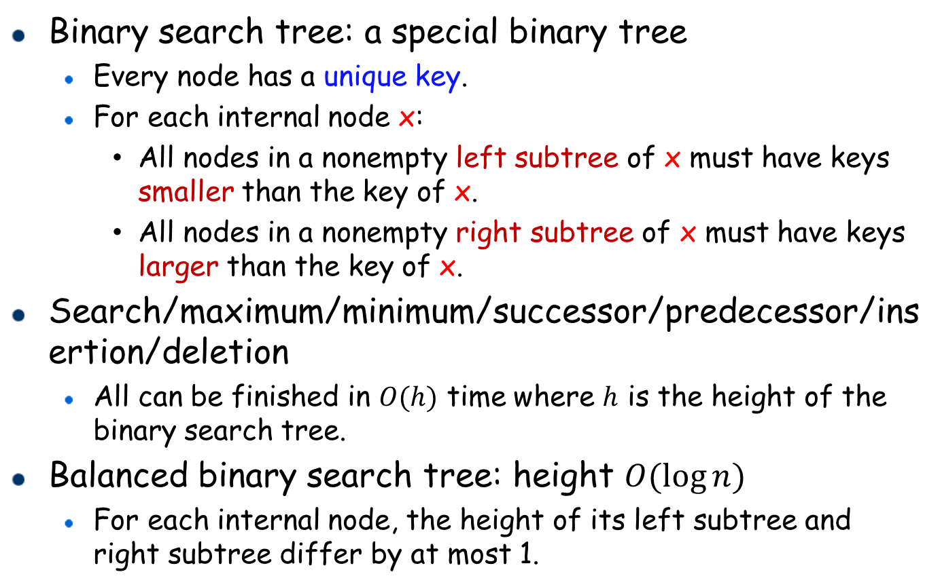
Recap: Binary Search Tree
20
Binary search tree: a special binary tree
Every node has a unique key.
For each internal node x:
All nodes in a nonempty left subtree of x must have keys smaller than the key of x.
All nodes in a nonempty right subtree of x must have keys larger than the key of x.
Search/maximum/minimum/successor/predecessor/insertion/deletion
All can be finished in $O(h)$ time where $h$ is the height of the binary search tree.
Balanced binary search tree: height $O(\log{n})$
For each internal node, the height of its left subtree and right subtree differ by at most 1.
12
22
10
15
25

Slide 3
Dynamic Rebalancing: AVL-Tree

Slide 4
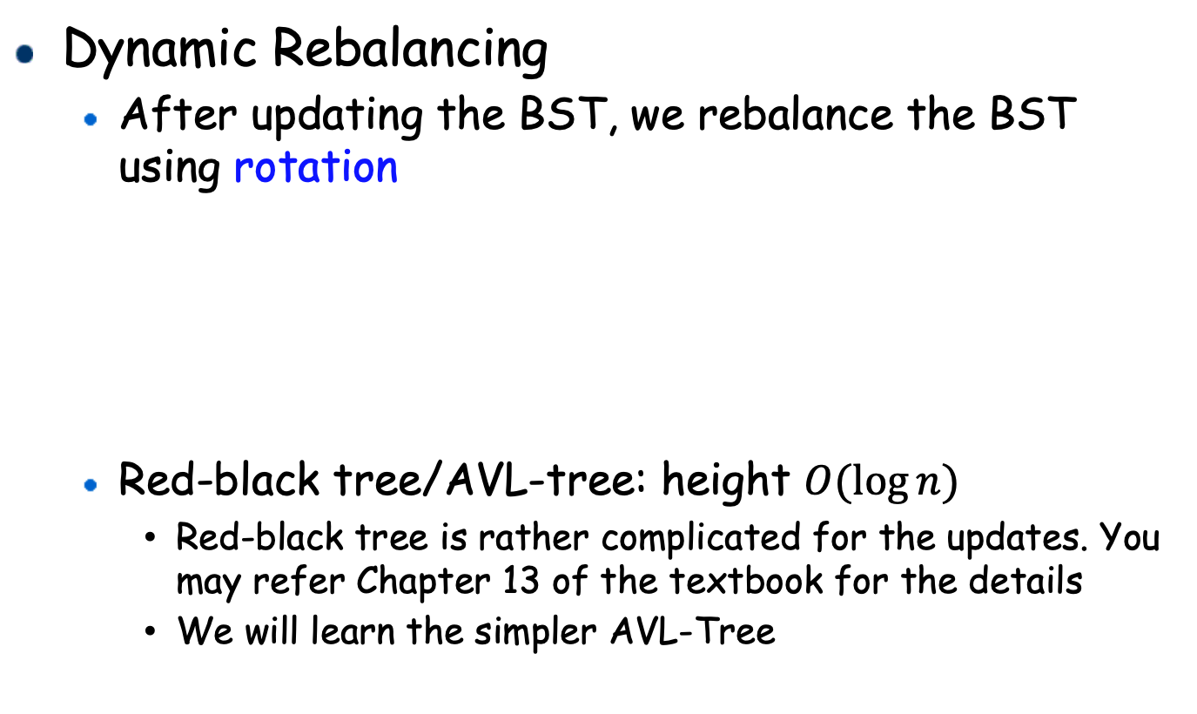
How to Keep a BST Balanced?
Dynamic Rebalancing
After updating the BST, we rebalance the BST using rotation
Red-black tree/AVL-tree: height $O(\log{n})$
Red-black tree is rather complicated for the updates. You may refer Chapter 13 of the textbook for the details
We will learn the simpler AVL-Tree
7
6
6
5
7
5

Slide 5
Rotations
Rotation allows us to change the structure without violating the binary search tree property
Left-Rotation on B
A
B
B
A
Right-Rotation on A
>A
<A
<B
<A
>A
<B
>B
>B

Slide 6
Rotation Examples
30
15
Right-Rotation on 30
15
40
13
30
13
16
5
16
40
5
Left-Rotation
A
B
B
A
Right-Rotation
>A
<A
<B
<A
>A
<B
>B
>B

Slide 7






AVL-Tree
An AVL-Tree is a balanced binary search tree where each node maintains additional information about:
the height of its left and right subtrees, denoted as $h_{l}$ and $h_{r}$, respectively.
By storing the subtree heights, a non-leaf node knows whether it has become imbalanced.
$$h_{l}:1$$
3
$$h_{r}:2$$
2
7
For leaf node, $h_{l}=h_{r}=0$, we omit for simplicity
$$h_{l}:1$$
$$h_{r}:1$$
5
9
An example of an AVL-Tree

Slide 8

AVL-Tree: Handling Imbalance
When we update the AVL-Tree, we may get nodes imbalanced, thus violating the property of AVL-Trees.
We do tree rotations to make it balanced again.
We only need to consider 2-level imbalance of a node $u$, such that for node $u$, ${|h}_{l}−h_{r}|=2$ after an update (insertion/deletion), and all its descendants are balanced.
When inserting/deleting, we will only change the height of the nodes along the search path by at most 1.
…

Slide 9
Imbalance After Updates
5
5
4
7
4
7
2
2
9
9
Insert node 3
Insert node 1
1
3
5
6
Delete node 5
3
7
3
7
2
4
6
2
4
1
1

Slide 10

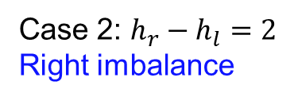

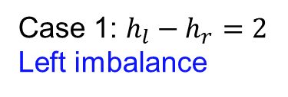


2-Level Imbalance
Two cases:
A
A
$$h+2$$
$$h$$
$$h$$
$$h+2$$
<A
>A
<A
>A
Case 1: $h_{l}−h_{r}=2$
Left imbalance
Case 2: $h_{r}−h_{l}=2$
Right imbalance

Slide 11






2-Level Imbalance
For left imbalance
We further have two cases
A
A
B
B
$h$
$h$
>A
>A
$$h$$
$$h+1$$
>B
>B
<A
$$h+1$$
$h$ or $h+1$
<A
<A
<A
Case 1.2: Left-Right
Case 1.1: Left-Left

Slide 12






2-Level Imbalance
For right imbalance
We further have two cases (mirror cases for left imbalance)
Right-Right mirrors to Left-Left, Right-Left mirrors to Left-Right
A
A
B
B
$h$
$h$
<A
<A
>A
$h+1$
$h$
$$h+1$$
>A
$h$ or $h+1$
<B
>B
>B
<B
Case 2.1: Right-Right
Case 2.2: Right-Left

Slide 13


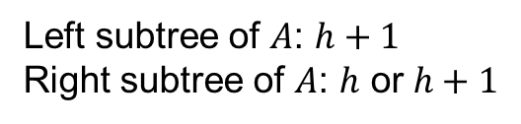







Rebalancing Left-Left Imbalance
Right-Rotation on A
$h+2$
A
B
$h$
$h+1$
$x+1$
B
A
$h+1$
$x$
$h$
$x$
>A
<A
<A
<A
>A
<A
>B
>B
Case 1.1: Left-Left
Left subtree of $A$: $h+1$
Right subtree of $A$: $h$ or $h+1$
$x=h$ or $h+1$

Slide 14


















A Running Example: Left-Left Case
5
Node 4 Left-Left imbalance. Right-rotation on Node 4
5
$$h_{l}:3$$
$$h_{r}:2$$
$$h_{l}:2$$
$$h_{r}:2$$
4
7
2
7
$$h_{l}:2$$
$$h_{r}:1$$
$$h_{l}:1$$
$$h_{r}:1$$
$$h_{r}:1$$
2
1
4
9
$$h_{l}:1$$
9
1
Right-Rotation on A
$h+2$
A
B
$h$
$h+1$
$x+1$
B
A
$h+1$
$x$
$h$
$x$
>A
<A
<A
<A
>A
<A
>B
>B

Slide 15





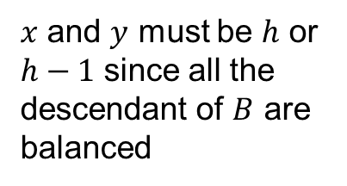











Rebalancing Left-Right Imbalance
Double rotation: Left-rotation on B, then right-rotation on A
A
A
$$h+2$$
$h$
$h+2$
$h$
B
B
$$h+1$$
$h$
$h+1$
W
$h$
C
$x$
$y$
W
V
T
R
T
$x$ and $y$ must be $h$ or $h−1$ since all the descendant of $B$ are balanced
U
Case 1.2: Left-Right
$h+1$
C
$h+1$
B
A
$h$
$x$
$y$
$h$
T
U
V
W

Slide 16















A Running Example: Left-Right Case
left rotation on 4
8
Right rotation on 8
8
$$h_{l}:3$$
$$h_{r}:1$$
$$h_{l}:3$$
$$h_{r}:1$$
5
$$h_{l}:2$$
$$h_{r}:2$$
4
10
5
10
$$h_{l}:1$$
$$h_{l}:2$$
$$h_{r}:1$$
$$h_{r}:2$$
4
$$h_{l}:1$$
8
$$h_{r}:1$$
4
$$h_{l}:1$$
2
5
$$h_{l}:1$$
6
$$h_{r}:1$$
2
6
2
10
6
A
$h+2$
$h$
$h+1$
C
$h+1$
B
$h$
$h+1$
W
B
$h$
A
C
$x$
$y$
$h$
$x$
$y$
T
U
V
W
V
T
U

Slide 17









Rebalancing Right Imbalance
Right-Right imbalance:
Fix by a left rotation
A
Rotation
$h$
$h+2$
B
$x+1$
$h+1$
B
$h+1$
$h$
A
$x$
$x$
<A
>A
>A
<B
>B
<A
>B
<B
Case 2.1: Right-Right
$x=h$ or $h+1$

Slide 18
















Rebalancing Right Imbalance
Right-Left imbalance:
Fix by double rotation
A
$$h$$
$h+2$
Double rotation:
Right-rotation on node B, Left-rotation on node A
$h$
A
$h+1$
B
$h$
T
B
C
$$h+1$$
$h$
$x$
$y$
W
T
U
V
L
$x$ and $y$ must be $h$ or $h−1$ since all the descendant of $B$ are balanced
W
$h+1$
C
$h+1$
Case 2.2: Right-Left
$h$
A
B
$x$
$y$
$h$
T
U
V
W

Slide 19


















Example: AVL-Tree Insertion
Step 1: Do normal binary search tree insertion
Step 2: Rebalancing the AVL-Tree: bottom-up
3
Node 4 balanced, check if its parent is balanced
$$h_{l}:1$$
3
$$h_{r}:2$$
$$h_{l}:1$$
$$h_{r}:2$$
Insert 4
2
7
2
7
$$h_{l}:1$$
$$h_{r}:1$$
$$h_{l}:1$$
$$h_{r}:1$$
5
9
5
9
4
Node 5: Update subtree height, still balanced
Check its parent
Node 7: Update subtree height,
still balanced, check its parent
3
3
$$h_{l}:1$$
$$h_{r}:2$$
$$h_{l}:1$$
$$h_{r}:2$$
2
7
2
7
$$h_{l}:1$$
$$h_{r}:1$$
$$h_{l}:2$$
$$h_{r}:1$$
5
$$h_{l}:1$$
9
5
$$h_{l}:1$$
9
4
4

Slide 20










Example: AVL-Tree Insertion
3
Node 3: Update subtree height, Imbalanced,
Case 2.2 Right-Left,
Double rotation
$$h_{l}:1$$
$$h_{r}:3$$
5
$$h_{1}:2$$
$$h_{r}:2$$
2
7
3
$$h_{l}:2$$
$$h_{r}:1$$
$$h_{l}:1$$
$$h_{r}:1$$
7
$$h_{r}:1$$
5
$$h_{l}:1$$
9
2
4
9
4
Case 2.2 Right-Left: double rotation
A
$$h$$
$h+2$
$h+1$
C
$h+1$
$h+1$
B
A
B
$h$
$h$
T
$x$
$y$
$h$
C
$x$
$y$
W
T
U
V
W
U
V

Slide 21
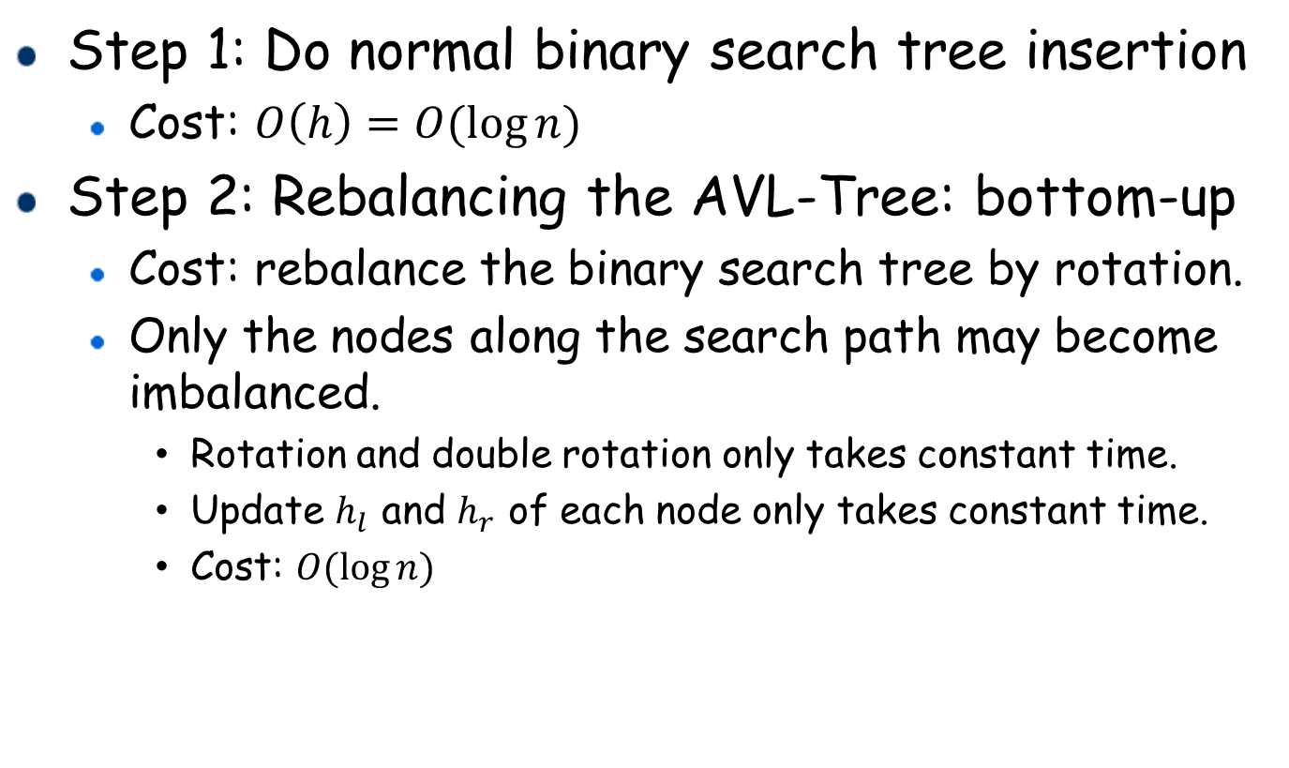
AVL-Tree: Cost of Insertion
Step 1: Do normal binary search tree insertion
Cost: $O\left(h\right)=O(\log{n})$
Step 2: Rebalancing the AVL-Tree: bottom-up
Cost: rebalance the binary search tree by rotation.
Only the nodes along the search path may become imbalanced.
Rotation and double rotation only takes constant time.
Update $h_{l}$ and $h_{r}$ of each node only takes constant time.
Cost: $O(\log{n})$

Slide 22













AVL-Tree: Deletion
Step 1: Do normal binary search tree deletion
Step 2: Rebalancing the AVL-Tree: bottom-up
3
3
Node 2: Update height, balanced
check if its parent is balanced
$$h_{l}:2$$
$$h_{r}:3$$
$$h_{l}:2$$
$$h_{r}:3$$
Delete node 1
$$h_{l}:1$$
2
7
2
7
$$h_{l}:2$$
$$h_{r}:1$$
$$h_{l}:2$$
$$h_{r}:1$$
1
5
9
5
9
$$h_{l}:1$$
$$h_{l}:1$$
4
4
3
Node 3: Update height, imbalanced,
Case 2.2: Right-Left
Double rotation
$$h_{l}:1$$
$$h_{r}:3$$
2
7
$$h_{l}:2$$
$$h_{r}:1$$
5
9
$$h_{l}:1$$
4

Slide 23









AVL-Tree: Deletion
5
$$h_{l}:1$$
3
$$h_{l}:2$$
$$h_{r}:2$$
$$h_{r}:3$$
3
7
2
7
$$h_{l}:1$$
$$h_{r}:1$$
$$h_{l}:2$$
$$h_{r}:1$$
$$h_{l}:1$$
5
2
4
9
$$h_{l}:1$$
9
4
A
Case 2.2
Double rotation
$$h$$
$h+2$
$h+1$
C
B
$h+1$
$h+1$
$h$
T
$h$
A
B
C
$x$
$y$
$h$
$x$
$y$
W
T
U
V
W
U
V

Slide 24

AVL-Tree Deletion (Delete 11)
8
8
Node 12 imbalanced
Case 1.2 Left-Right
8
Delete 11
3
11
3
12
3
10
2
6
9
2
6
9
12
2
6
9
12
1
5
7
10
1
5
7
10
1
5
7
Omit $h_{1}$ and $h_{r}$ for simplicity
4
4
4
A
$h+2$
$h$
C
$h+1$
$h+1$
B
B
$h$
$h+1$
W
$h$
A
$x$
$y$
$h$
C
$x$
$y$
T
U
V
W
V
T
U

Slide 25
AVL-Tree Deletion (Delete 11)
8
6
Node 8 still imbalanced
Case 1.2 Left-Right
3
10
3
8
2
6
9
12
2
5
7
10
1
5
7
1
4
9
12
4
A
$h+2$
$h$
C
$h+1$
$h+1$
B
B
$h$
$h+1$
W
$h$
A
$x$
$y$
$h$
C
$x$
$y$
T
U
V
W
V
T
U

Slide 26

AVL-Tree: Cost of Deletion
Step 1: Do normal binary search tree deletion
Cost: $O\left(h\right)=O(\log{n})$
Step 2: Rebalancing the AVL-Tree: bottom-up
Cost: rebalance the binary search tree by rotation.
Only the nodes along the search path down to the successor may become imbalanced.
Rotation and double rotation only takes constant time.
Update $h_{l}$ and $h_{r}$ of each node only takes constant time.
Cost: $O(\log{n})$

